Slide 1



Sitecore XM Cloud Developer Certification Crash-Course Stoneman to Superman
60 minutes

Slide 2
Disclaimer
The Sitecore eLearning is the original source of truth. Go through the topics and links there. This material is supplementary to that guide.

Slide 3
About XM Cloud Developer Certification Exam

Slide 4
Exam Details
As with anything practical, passing this exam doesn’t guarantee you are an expert in this area, its just to certify that you have XM Cloud basics intact
Easier to pass and relate to concepts if you passed the Sitecore 10 Developer Exam
Original Cost of exam is $350 USD but check with your work organization if there are any partner discounts / coupon codes
Online proctored exam, can take at your place of convenience on a scheduled date and time
The day prior to exam date, go to Kryterion Web assessor site and check all prerequisites are available in your machine
Keep your desk and surroundings free of clutter and possibly move your desk to corner surrounded by walls as much
Remove any sticky notes or papers on wall or around your exam desk
Need a web cam that can be moved to the side to show your hands, eyes and keyboard
No external disturbance during exam like answering doorbells or phone calls

Slide 5
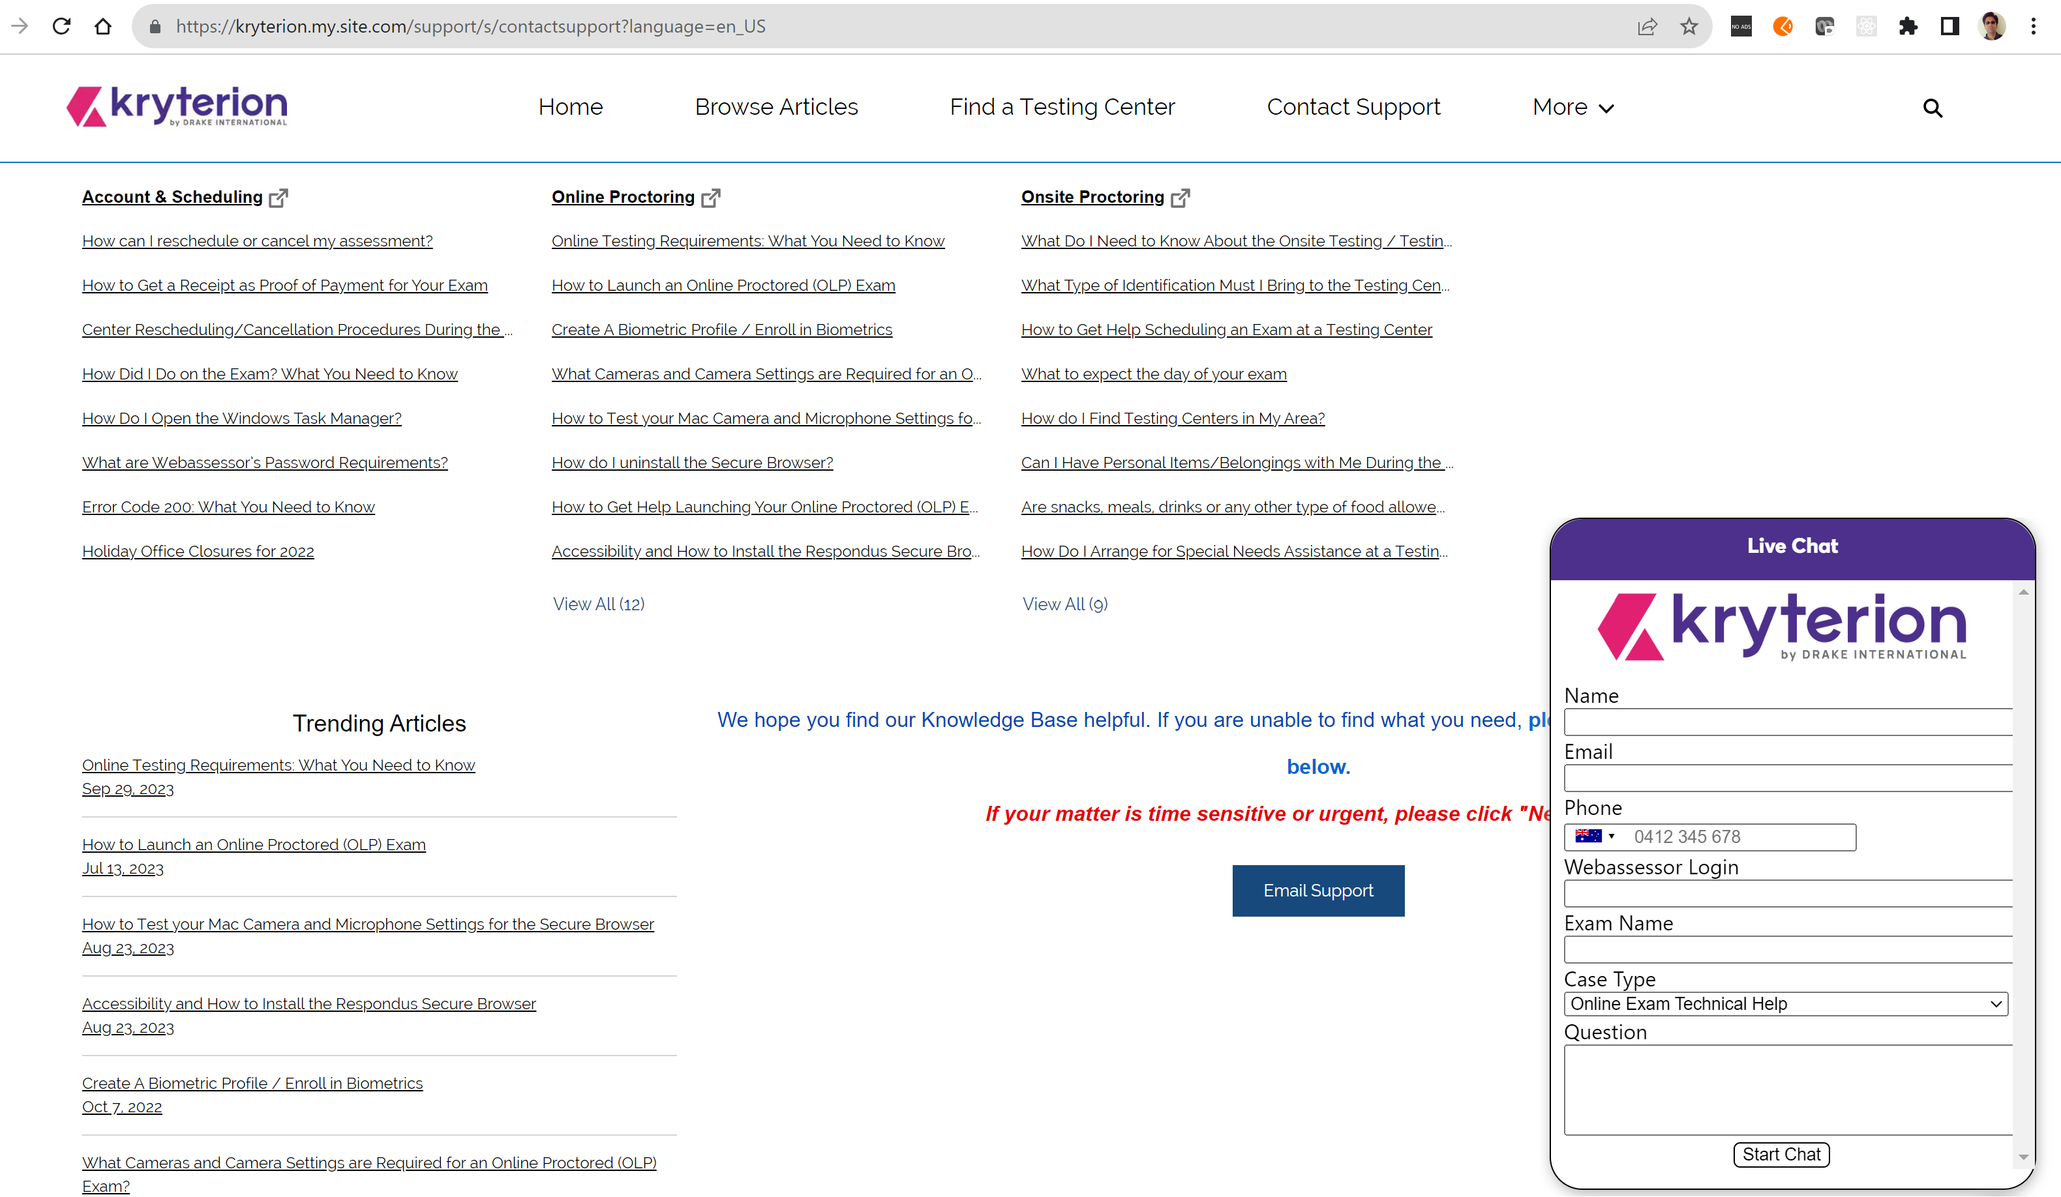
Exam Details
On the exam date, be 15 minutes earlier than the scheduled time, you can anyway start the exam only when launch button is visible in the Kryterion assessor page
At any point or time in the exam, you can be intervened by the invigilator and exam will be paused during that time
Kryterion helpline number: In Kryterion Contact Support page, click “Need Help?” button in the right bottom corner and there you can select your country and find Kryterion support phone number:

Slide 6
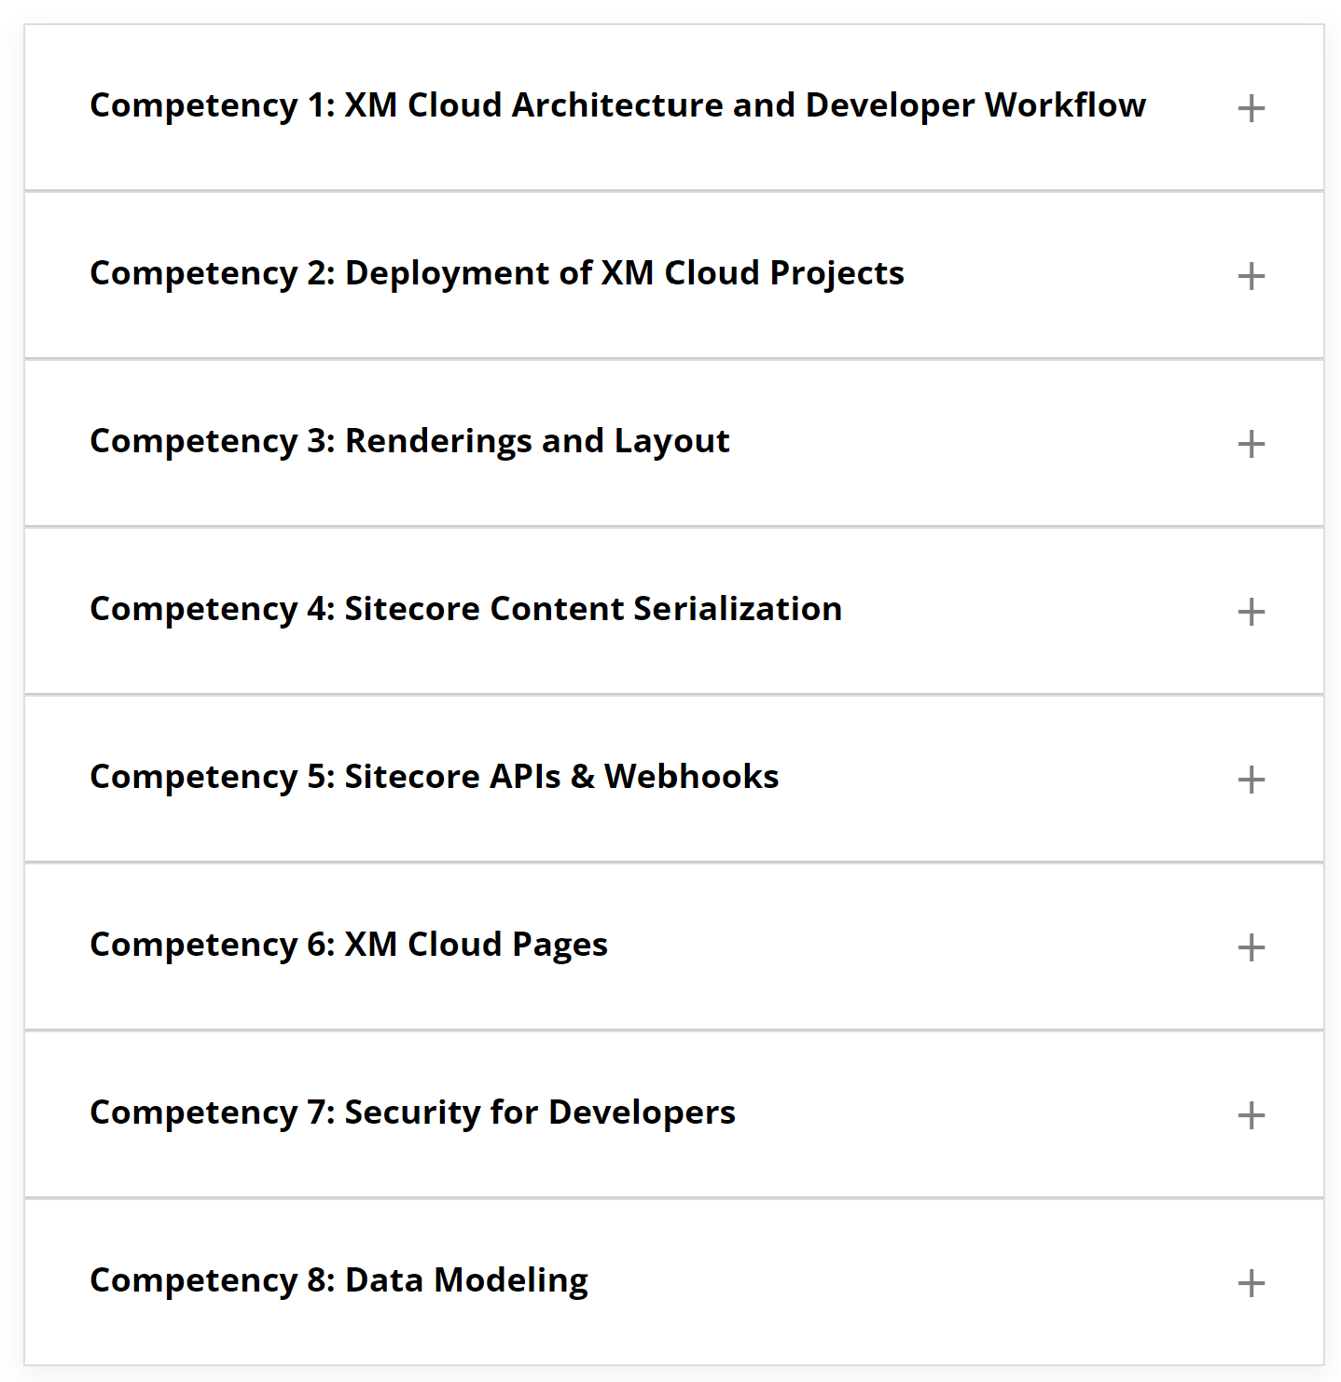
Exam Competencies

Slide 7
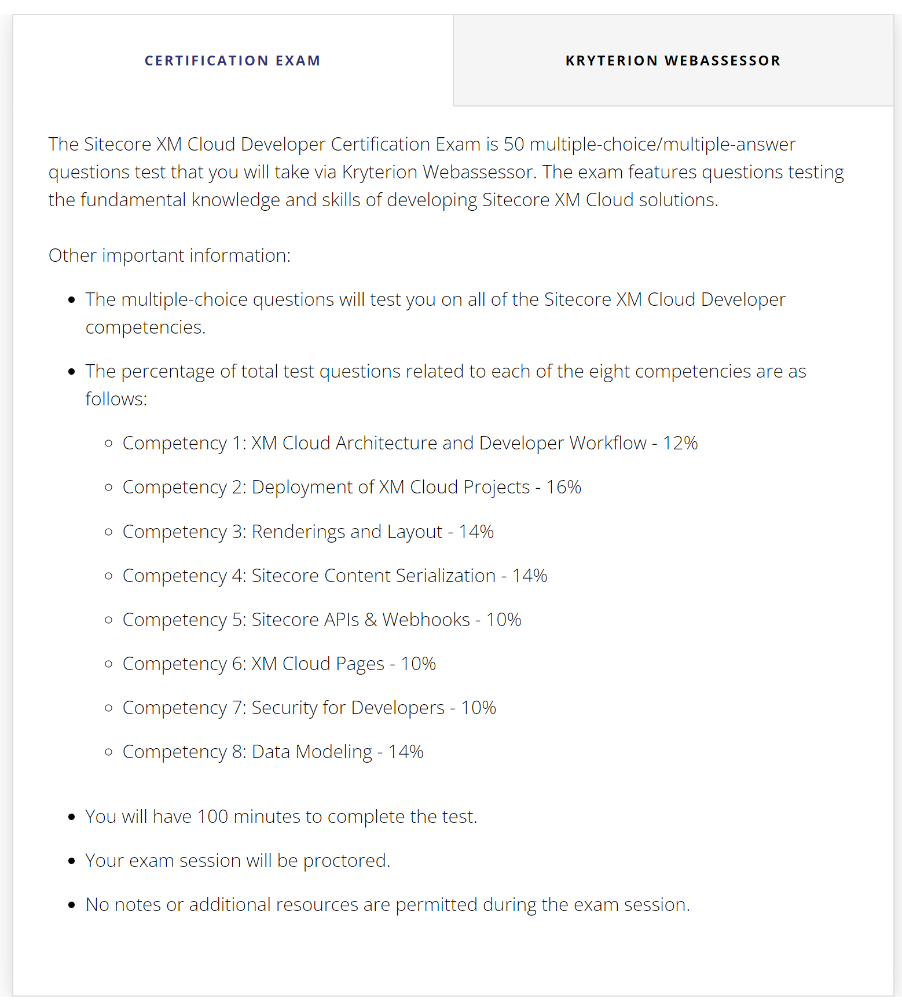
Exam Question Split-up
Competency | No. of questions
1 | 6
2 | 8
3 | 7
4 | 7
5 | 5
6 | 5
7 | 5
8 | 7
Total | 50

Slide 8
Exam Competencies
8 test areas, 50 questions, 100 minutes duration
Multiple-choice questions and you can mark a question for review and return anytime before submitting
Result is available on screen as soon as submitting the exam
Most questions have 4 answer options except a few having more than 4 options
Some areas have more weightage than others
Pass percentage is 80
No negative markings
https://learning.sitecore.com/learn/course/1253/play/1896:710/study-guide-xm-cloud-developer-certification-exam

Slide 9
Exam Competencies
A very basic exam to test XM Cloud concepts/terms, Tip: thorough the Sitecore XM Cloud documentation
Questions could delve into general Sitecore concepts like CLI, security, templates too
No code-based questions
In questions with multiple correct answers, all options “could” be correct
Don’t select all options unless sure since exam evaluator might see only the correct combination
https://learning.sitecore.com/learn/course/1253/play/1896:710/study-guide-xm-cloud-developer-certification-exam

Slide 10
Exam Preparation Information
Exam Preparation Duration: 30-40 hrs (one-two weekends)
Sitecore XM Cloud Developer Curriculum/eLearning
Sitecore XM Cloud Documentation
Sitecore and Security Basics
XM Cloud Sitecore Discover Videos
Sitecore CLI Basics

Slide 11
Competency 1
XM Cloud Architecture and Developer Workflow

Slide 12
Competency 1 (6 questions)
Define Sitecore XM Cloud-specific terminology
Describe the benefits of cloud and SaaS architecture for composable DXP foundations
Define key components within the developer workflow for XM Cloud
Manage sites within site collections
Resources: XM Cloud terminology(opens in a new tab)
Sitecore-first development workflow(opens in a new tab)
Code-first development workflow(opens in a new tab)
Site collections(opens in a new tab)

Slide 13
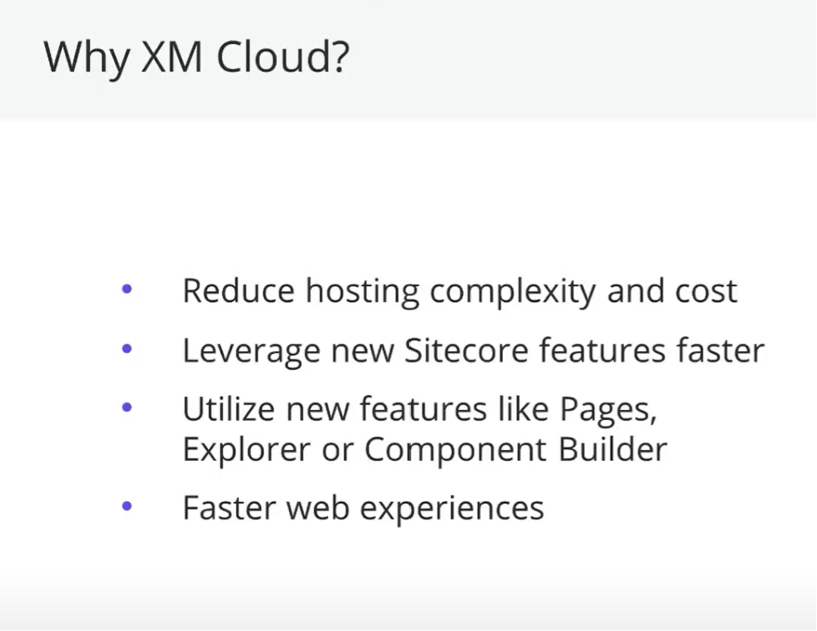
Subscription-based SaaS
Automatic version upgrades
Portal-based organization access/user invitation
Headless support
DevOps integration
Decoupled rather than monolithic model
Integrate best-of-breed products
Docker-based
Web-based Components support Static Site Generation
Front-End as a Service
SDK / Service support
Edge / CDN-based deployment
https://www.youtube.com/watch?v=6WMzaK-3swI

Slide 14




Sitecore Cloud Portal - https://portal.sitecorecloud.io
In the Sitecore Cloud Portal, you can assign the following app roles: User and Admin
Organization
Owner
Users
Apps
XM Cloud
Content Hub ONE
CDP
In the Sitecore Cloud Portal, you can assign the following app roles: User and Admin
https://doc.sitecore.com/xmc/en/developers/xm-cloud/creating-users-in-xm-cloud.html

Slide 15
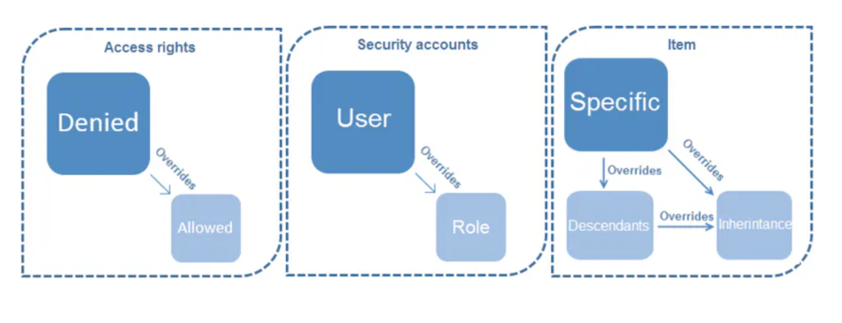
XM Cloud Access Rights
- Default for item access right is deny
- Default for inheritance is allow
- Deny prevails over allow for items
- User access overrules role access
- Allow prevails over deny during inheritance
https://doc.sitecore.com/xmc/en/developers/xm-cloud/assigning-access-rights.html

Slide 16
Competency 1 - Multi-Site Structure
Company
Site Collection Folder
Brand Collection
Site Collection
Brand
Site Folder
Region
Site
Country
https://doc.sitecore.com/xmc/en/developers/xm-cloud/grouping-of-headless-site-collections-and-sites.html

Slide 17







Developer to End-User XM Cloud Stack Transition
F
I
L
E
S
Y
S
T
E
M
C
L
I
C
O
N
T
A
I
N
E
R
S
L
O
C
A
L
I
N
S
T
A
N
C
E
P
R
E
V
I
E
W
A
P
I
R
E
P
O
P
R
O
V
I
D
E
R
X
M
C
L
O
U
D
P
U
B
L
I
S
H
E
X
P
E
D
G
E
D
E
L
I
V
E
R
Y
A
P
I
R
E
N
D
E
R
I
N
G
H
O
S
T
B
R
O
W
S
E
R
D
E
P
L
O
Y
E
D
I
T
O
R
Developer
End-User

Slide 18

Competency 1 - Multi-Site Design / Deployment
Site
Brand/Layout
Language/Content
Editing Host
Rendering Host
Think From load-time perspective
https://doc.sitecore.com/xmc/en/developers/xm-cloud/site-collections.html
https://doc.sitecore.com/xmc/en/developers/xm-cloud/grouping-of-headless-site-collections-and-sites.html

Slide 19
Code-First Approach (Disconnected mode)
Download and install latest version of Node JS
Node --version
<Node Version>
npm install -g @sitecore-jss/sitecore-jss-cli
Package deployed to %USERPROFILE%\AppData\roaming\npm\node_modules
jss --help
JSS CLI is running in global mode because it was not installed in the local node_modules folder.
npx create-sitecore-jss --templates nextjs,nextjs-styleguide --appName my-jss --fetchWith REST --language da-DK --destination my-jss --prePushHook false --hostName my-jss.dev.local --prerender SSG
My-jss folder created with code artifacts
Cd my-jss
jss start
Site hosted locally
Developer
Cmd prompt
File System

Slide 20

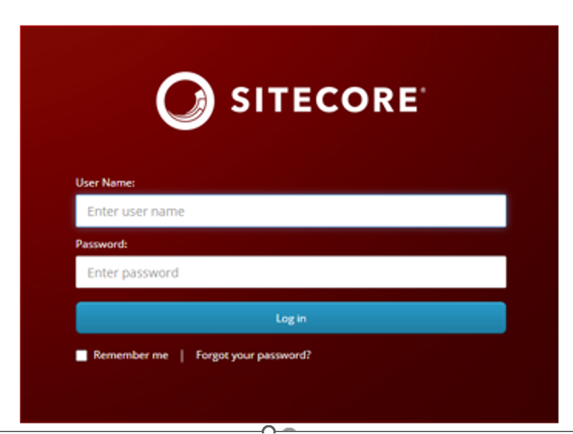
Code-First Approach (Disconnected mode)
Manifest json
Manifest API
FED
App Import API

Slide 21
JSS Env File Support
JSS CLI honors loading variable values from .env files. Here is the top-down order of priority in case if there are multiple .env files
.env.${NODE_ENV}.local
.env.local, not checked if NODE_ENV is "test"
.env.${NODE_ENV}
.env
https://nextjs.org/docs/pages/building-your-application/configuring/environment-variables

Slide 22
Important points
In the Sitecore Cloud Portal, if a team member has an Organization Admin or Organization Owner role, they have an Admin role in all XM Cloud apps in the organization.
You cannot delete the user or remove their administrator role in XM Cloud. You must delete the user or remove their administrator role from the Sitecore Cloud Portal.
Configure rendering Datasource location to restrict content editors to select content from a specific location in the content tree
Configure Datasource template to filter content items based on a template
https://doc.sitecore.com/xmc/en/users/xm-cloud/assign-a-page-design-to-a-template.html

Slide 23
Important points
To use XM Cloud Deploy, you must have an Organization Admin or Organization Owner role in your Sitecore Cloud Portal organization. An organization admin or organization owner can grant a team member access to the XM Cloud Deploy app by changing their role.
To create a new XM Cloud project, you must be an organization admin or organization owner in an XM Cloud organization.
In the Experience Editor, you can create placeholder restrictions on specific pages instead of all the pages that belong to a site.
Do not add components directly to page designs. Page designs cannot hold the information on their own, but refer to the information stored in the partial designs. So if you add components directly to the page designs, they do not render on the page.
In the publishing pipeline, dependencies are calculated at the item level. For example, you might change a data source item of a page in the navigation. Because the page is dependent on the data source item, and is rendered by the navigation component, any page containing the navigation component has to be republished.
In XM Cloud pages you can assign a template to a page design and also duplicate/rename data template but data templates must be created in Content editor
https://doc.sitecore.com/xmc/en/users/xm-cloud/assign-a-page-design-to-a-template.html

Slide 24
Competency 2
Deployment of XM Cloud Projects

Slide 25
Competency 2 (8 questions)
Log into and navigate the XM Cloud Deploy Application
Deploy a project using a starter template
Set up an XM Cloud local development environment
Define the attributes of a starter template
Deploy a project using Source Code Provider
Define compatibility requirements for deploying your own code
Configure repositories and environments
Connect to your repository
Create environments such as production, QA, and test
Configure deploys on demand or automatically based on code commits to a watched branch
Review project details to determine deployment status
Review logs to troubleshoot errors
Resources: Getting started with XM Cloud (opens in a new tab)
Deploying XM Cloud (opens in a new tab)
XM Cloud Deploy app(opens in a new tab)
Create an XM Cloud project from existing source code in the XM Cloud Deploy app (opens in a new tab)
Connect Sitecore Pages to your local XM Cloud instance(opens in a new tab)
Manage an environment(opens in a new tab)
Create an XM Cloud project using the Sitecore CLI(opens in a new tab)

Slide 26
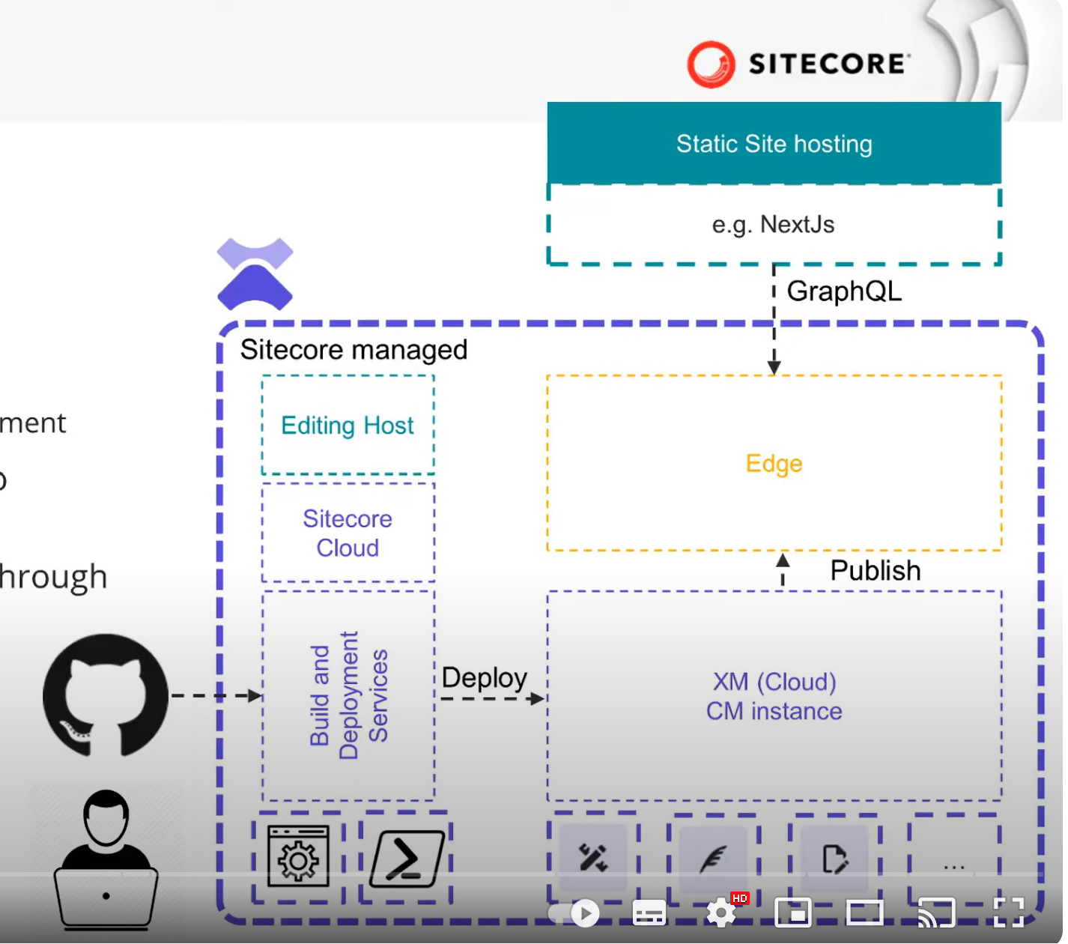
Competency 2 - Sitecore XM Deploy Architecture Overview

Slide 27
PowerShell
Competency 2 - Deploy application code using CLI
XM Cloud
User
dotnet sitecore cloud login
*
<User Code>
Select Organization
*
Organization
dotnet sitecore cloud project create –name <proj name>
1
<Project Id>
*
Project
dotnet sitecore cloud environment create –name <env name> –project-id <Project Id>
1
*
Environment
<Env Id>
*
dotnet sitecore cloud deployment create –environment-id <Env Id> --upload
*
Deployment
<XM Cloud code deployed Url>
*
*
XM Cloud Instance
https://doc.sitecore.com/xmc/en/developers/xm-cloud/walkthrough--creating-an-xm-cloud-project-using-the-sitecore-cli.html

Slide 28
Competency 2 – XM Cloud Deployment
XM Cloud Project Creation Methods
Project and Environment Interlink
XM Cloud Deploy App
Project
Development Environment
Testing Environment
Command Line Interface (CLI)
Production Environment
REST APIs

Slide 29
Competency 2 - Manage Environment
Create a new environment
Create a build and deploy to an environment
Deploy a build to another environment
Change the repository branch linked to an environment
Link an environment to a different branch
Enable automatic deployment when you push to the linked repository branch
View environment details
Delete environment
Open the XM Cloud dashboard
Change an environment name
View environment logs

Slide 30



XM Cloud Deployment Topology Overview
CM Instance
Page Layouts
Experience Edge
G
R
A
P
H
Q
L
Datasource Configurations
Publish
Components
Personalization Settings
End-Users

Slide 31
Competency 2 - XM Cloud Deploy App
Configurations
GitHub Repository
Experience Edge
Sitecore Artifacts
XM Cloud Instance
Rendering Host
Edge Publishing target
Identity Configuration
Editing Host
CM Warm-up
Schema Population
Project / Environment Creation
Provision
Build
Deploy
Post Actions
(xmcloud.build.json)
Reindexing
DB Creation
GitHub Connection
Publishing
Index Configuration
Deploy SCS Modules
Experience Edge Connector
DB Artifacts
Configurations
https://www.youtube.com/watch?v=wdyIkUb8uDY&t=345s

Slide 32

(Default) Editing Host vs Rendering Host
Editing Host
Rendering Host
C
O
D
E
/
C
O
N
F
I
G
R
E
P
O
P
R
O
V
I
D
E
R
CDN - 1
X
M
C
L
O
U
D
E
X
P
E
D
G
E
C
D
N
P
R
O
V
I
D
E
R
D
E
P
L
O
Y
D
E
P
L
O
Y
Experience Editor
Front End App Instance
CDN - 2
Developer
Front End App Instance
CDN - 3
Pages
Front End App
Front End App Instance
Distributed Users
https://doc.sitecore.com/xmc/en/developers/xm-cloud/editing-hosts-and-rendering-hosts.html

Slide 33




Competency 2 - Creating a new GitHub Connection
Github Personal, organization, or enterprise account
Github Connection
Repository(s)
Deploy App
All Repository or Selected Repository?
Request and Authorize
Approve, Authorize and Install
Github Organization member
Github Organization owner
https://doc.sitecore.com/xmc/en/developers/xm-cloud/manage-connections-for-source-control-and-hosting-providers.html

Slide 34
Competency 2 - Creating a new GitHub Connection
If you are a GitHub Organization member, you must first Authorize & Request the Sitecore Deploy GitHub app. Then a GitHub Organization owner must Approve, Install, & Authorize your request.
If you only want to create projects from existing source code, you need to Install & Authorize the Sitecore Deploy GitHub app for the repositories that contain your existing code.
If you want to create projects from the starter foundation, you need to Install & Authorize the Sitecore Deploy GitHub app for All repositories. Note that you can limit the deploy app’ access to just the cloned repo if you clone the starter foundation code manually since it now the repo is similar to existing source code repo.
https://doc.sitecore.com/xmc/en/developers/xm-cloud/manage-connections-for-source-control-and-hosting-providers.html

Slide 35

Competency 2 - Creating a new GitHub Connection
Install and authorize the Sitecore Deploy GitHub App on your personal account, organization, or enterprise
You CANNOT create a new GitHub connection with an Enterprise Managed User account
All GitHub repositories created by the Deploy App have private visibility
https://doc.sitecore.com/xmc/en/developers/xm-cloud/manage-connections-for-source-control-and-hosting-providers.html

Slide 36
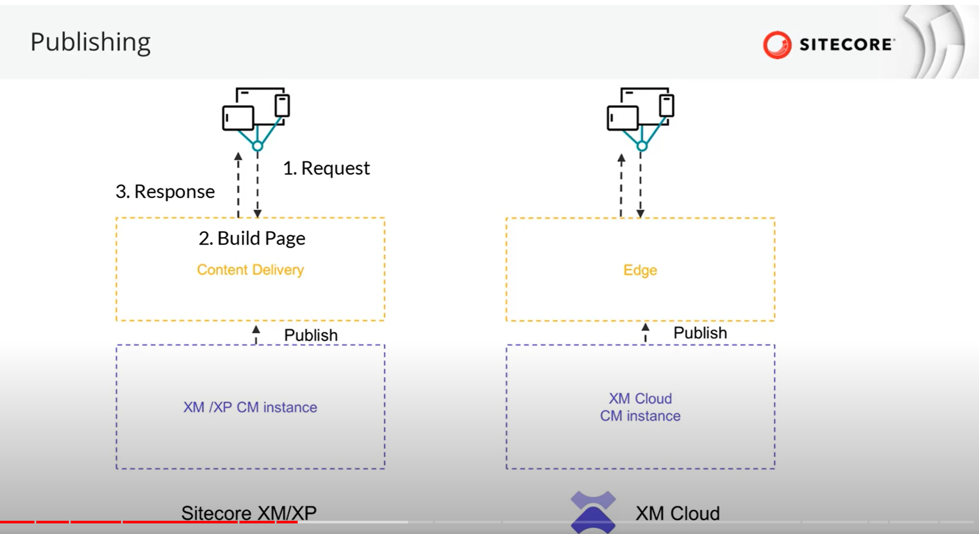
Competency 2 - Sitecore XM Deploy Architecture Overview

Slide 37
Competency 3
Renderings and Layouts

Slide 38
Competency 3 (7 questions)
Create new components using the Component Builder
Create placeholder settings items and set allowed controls
Create and manage Page Designs and Partial Designs
Create a custom SXA module
Create component definition items
Set the compatible renderings on a rendering definition item
Set the Datasource location and data source template fields
Set up rendering parameters
Clone a rendering
Create and manage headless variants
Configure item security properly for existing and future items
Resources: (opens in a new tab)(opens in a new tab)(opens in a new tab)Renderings and rendering variants(opens in a new tab)
Building components(opens in a new tab)
Registering an external React component(opens in a new tab)
(opens in a new tab)Set placeholder restrictions(opens in a new tab)
Page designs(opens in a new tab)
Partial designs(opens in a new tab)
(opens in a new tab)(opens in a new tab)Create and assign a page design in the content editor(opens in a new tab)
Use the Component wizard to create a custom rendering(opens in a new tab)
Copy and customize a rendering(opens in a new tab)

Slide 39
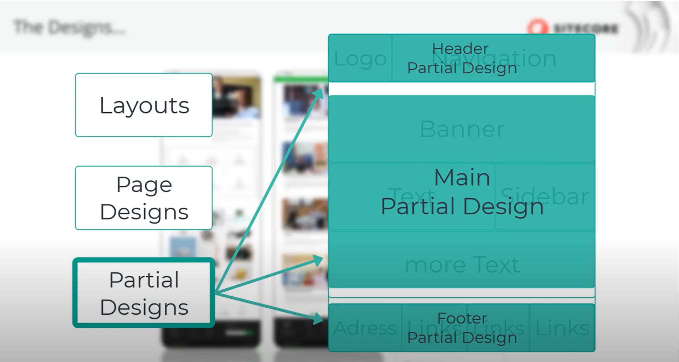
Competency 3 – Layouts / Page design / Partial design
https://www.youtube.com/watch?v=6WMzaK-3swI

Slide 40
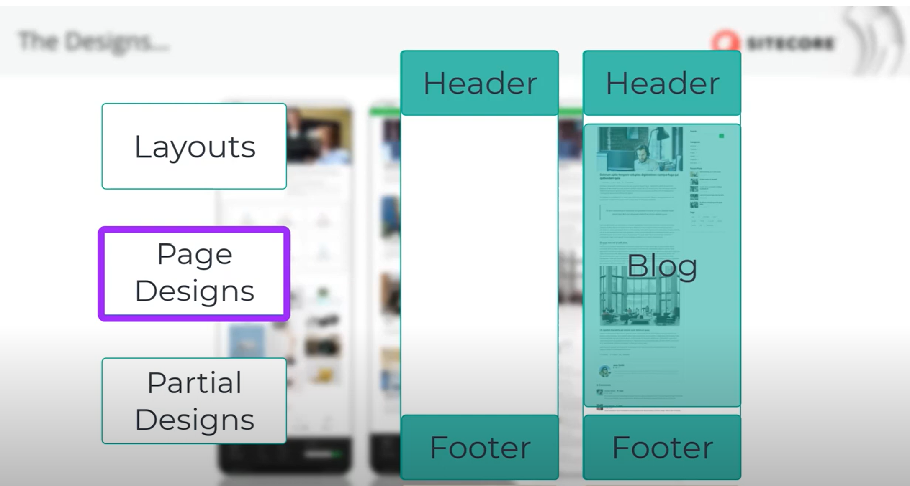
Competency 3 – Layouts / Page design / Partial design
https://www.youtube.com/watch?v=6WMzaK-3swI

Slide 41



Competency 3 - External components in Component Builder
Rendering Host
Deploy
Code-based Environment
Component Builder Interface (No-code/Low-code)
Sitecore Pages
npm install @sitecore-feaas/clientside
Rendering Host Url Setting
Registered Component
I
N
P
U
T
P
A
R
A
M
import * as FEAAS from "@sitecore-feaas/clientside/react"
registerComponent(component, options)
Registered Component
Index Component FEAAS.linkComponents()
Registered Component
Registered Component
Registered Component
Registered Component
Developer
Content Author
Preview
Content Author
https://doc.sitecore.com/xmc/en/developers/xm-cloud/walkthrough--registering-an-external-react-component.html

Slide 42
Competency 3 - External Components in Component Builder
The registered component is part of the components library (scoped to a project) and can be used and reused within XM Cloud Pages.
The registered component can be previewed in the component builder.
A content author using the component in Pages can enter values for the defined input parameters.
External components are previewed in a separate tab of the builder, and can't be previewed in Pages.
https://doc.sitecore.com/xmc/en/developers/xm-cloud/walkthrough--registering-an-external-react-component.html

Slide 43
Competency 4
Sitecore Content Serialization

Slide 44
Competency 4 (7 questions)
Serialize and deserialize items from source control using the Sitecore CLI
Connect to a local or remote XM Cloud hosted instance
Configure a Serialization Module with included paths and rules
Use serialization packages for continuous integration
Resources: (opens in a new tab)Sitecore Content Serialization(opens in a new tab)
Connect Sitecore Pages to your local XM Cloud instance(opens in a new tab)
Configure excluded fields(opens in a new tab)
Sitecore Content Serialization configuration reference(opens in a new tab)
(opens in a new tab)The CLI serialization command(opens in a new tab)

Slide 45


Competency 4 - Connect Local Docker instance with Sitecore Pages
Browser -1
Browser -2
https://pages.sitecorecloud.io
https://xmcloudcm.localhost/
Docker-based CM Instance
Local Front-End
Local Front-End
npm run start:connected
SITECORE_Pages_Client_Host=https://pages.sitecorecloud.io
SITECORE_Pages_CORS_Allowed_Origins=pages.sitecorecloud.io
Key: Sitecore.Pages.LocalXmCloudUrl
Value: https://xmcloudcm.localhost/
Browser -1 Local Storage
.env file
https://doc.sitecore.com/xmc/en/developers/xm-cloud/connect-xm-cloud-pages-to-your-local-xm-cloud-instance.html

Slide 46
Competency 4 - Connect Local Docker instance with Sitecore Pages
In your browser, navigate to https://pages.sitecorecloud.io. Open the developer tools console of your browser and find the local storage section.
In the Local Storage panel, click the entry for https://pages.sitecorecloud.io to reveal the local storage entries.
Create a new entry by adding a new row with the following values:
Key: Sitecore.Pages.LocalXmCloudUrl
Value: your local (XM Cloud) instance URL. For example, https://xmcloudcm.localhost/
Verify that your local Docker instance is configured to connect with XM Cloud Pages. If correctly configured, your .env file has the following environment variables:
SITECORE_Pages_Client_Host=https://pages.sitecorecloud.io
SITECORE_Pages_CORS_Allowed_Origins=pages.sitecorecloud.io
Refresh the https://pages.sitecorecloud.io page to see your local front-end application
https://doc.sitecore.com/xmc/en/developers/xm-cloud/connect-xm-cloud-pages-to-your-local-xm-cloud-instance.html

Slide 47
Competency 4- Content Sync with CLI
XM Cloud Environment
Local Instance
CLI
File System
dotnet sitecore cloud login --authority https://<authority-url> --cm http://<sitecore-instance> --audience https://<xm-cloud-audience-url> --allow-write true --client-credentials true --client-id <client-id> --client-secret <client-secret>
dotnet sitecore login --authority <localidentityserverurl> --cm <localcmserverurl> --allow-write true --client-credentials true --client-id <local-client-id> --client-secret <local-client-secret>
dotnet sitecore cloud environment connect -id <env id> --allow-write true -n xmcloud
dotnet sitecore environment connect -id <env id> --allow-write true –ref xmcloud -n local
.sitecore\user.json with env details
dotnet sitecore ser pull –n xmcloud
.yml files serialized
dotnet sitecore ser push –n local
https://doc.sitecore.com/xmc/en/developers/xm-cloud/walkthrough--setting-up-your-full-stack-xm-cloud-local-development-environment.html
https://doc.sitecore.com/xmc/en/developers/xm-cloud/log-in-to-a-sitecore-instance-with-sitecore-command-line-interface.html

Slide 48
Competency 4 - Useful CLI Commands
Command | Comments
dotnet sitecore cloud login | Login to XM Cloud before anything
dotnet sitecore cloud environment connect –id <id> --allow-write | To connect to a specific XM Cloud environment
dotnet sitecore cloud environment connect –ref <xmcloudname> --cm <local url> --allow-write –n <uniquename> | To connect to local instance before data sync from XM Cloud
dotnet sitecore connect [options] | The CLI connect command helps connect your environment to another existing environment. After the connection, your environment uses login information from the reference/base environment and can override the host and alloWrite properties.
dotnet sitecore ser pull –n <user.json xmcloud name> | Once you have a remote and local env setup from above two commands, you can pull content to local file system with this command
dotnet sitecore ser push –n <user.json local env name> | Once you have the local env setup as well content files serialized in file system, you can push content to local instance with this command
https://doc.sitecore.com/xmc/en/developers/xm-cloud/the-cli-connect-command.html

Slide 49
Competency 4 - Useful CLI Commands
Command | Comments
Dotnet sitecore cloud project create –name <project name> | Create a XM Cloud project
dotnet sitecore cloud environment create --name <name> --project-id <project-id> | Use the project id from above step to create the environment
dotnet sitecore cloud deployment create --environment-id <environment-id> --upload | Starts a deployment to the concerned XM Cloud environment
Dotnet sitecore cloud project list | Can be executed only after cloud login command to get list of projects in the organization
Dotnet sitecore cloud environment list –project-id <an id from above list command> | Lists all environments within a project
.\New-EdgeToken.ps1 –EnvironmentId <an env id from above cmd> | Before executing, this script should be present in file system pulled from starter kit GitHUB project
https://doc.sitecore.com/xmc/en/developers/xm-cloud/the-cloud-environment-command.html

Slide 50
Competency 6 - Configuration files
Sitecore.json:
In case of Sitecore Content Serialization, the project configuration file is named sitecore.json. It has several sections and properties, including module.json path, plugin details, serialization folder name among others
user.json:
Useful in case of Sitecore CLI non-interactive login since it stores cm,auth server details, access and refresh tokens
*.module.json:
Holds details about what Sitecore paths must be included in serialization alongwith scope and exclusion rules
scssconfig.json:
The JSS config file that has Sitecore instance details like deployment secret, API key, instance path among others
sitecore.config:
The Sitecore patch file under App_Config that has event handler details, patch folder and database details among others

Slide 51
Important points
In Sitecore Content Serialization, ItemandDescendants is default scope
In Sitecore Content Serialization, One-level down scope is ItemandChildren but ItemandDescendants includes grand children too
You can exclude fields from serialization by specifying them in the sitecore.json config file and any *modules.json file
If the path of a specific module file is not set in the sitecore.json file, the paths and related items included in the module will not be serialized when you run a push or pull command
You can use the sitecore ser watch command to monitor changes to content items in a Sitecore instance and automatically serialize the changes to your file system.
In case of Rules section properties in module.json, path and scope are mandatory
In case of includes section properties in module.json, name and path are mandatory
Roles in XM Cloud Organization-level: Organization Admin / Organization Owner and Organization User
In the Content Editor, you can set placeholder restrictions for your layout placeholders. These restrictions are applied on all pages in the site.

Slide 52
Competency 5
Sitecore APIs and Webhooks

Slide 53
Competency 5 (5 questions)
Use Experience Edge API to query an item, layout, or search
Use GraphQL Mutations to create, update, and delete items
Define and handle webhooks
Resources: (opens in a new tab)Sitecore Experience Edge for XM(opens in a new tab)
Sitecore Authoring and Management GraphQL API(opens in a new tab)
Webhooks(opens in a new tab)(opens in a new tab)

Slide 54
Competency 5 - Webhook Types
Webhook event handler
Configure a webhook event handler to send a request to a specified endpoint when a supported item event occurs.
Webhook submit action
A webhook submit action in the approved state of a workflow fires when an item using the workflow has moved to the state (e.g., rejected), then webhook sends an HTTP request to a specified endpoint.
Webhook validation action
A webhook validation action added to a command item of a workflow that changes the state from one state to another (in-review to approved) executes when the command executes, the webhook then sends an HTTP request to a specified endpoint to validate if state change (approval) must occur.
https://doc.sitecore.com/xmc/en/developers/xm-cloud/webhooks.html

Slide 55
Competency 5 - XM Cloud: webhooks, event handler and state-transition
Webhook event handler
Webhook event handler
Webhook submit action
Webhook submit action
Webhook validation action
Event-1
Event-2
State-1
State-2
Command
Webhook submit action: State-based:- Webhook attached to a workflow state: when the item reaches the state, webhook executes.
Webhook validation action: Command-based:- Webhook attached to command: when the command executes, the webhook executes. This can be used to invalidate state-change.

Slide 56
Experience Edge token API
Request JWT Token API
Bearer {Token}header
XM Cloud Deploy App: Edge Administration Client
Token REST API
Client Id, Client Secret
XM Cloud Deploy API
Request JWT Token API
Bearer {Token}header
Generate Organization Automation Client
XM Cloud Deploy API
Client Id, Client Secret
https://doc.sitecore.com/xmc/en/developers/xm-cloud/admin-api.html

Slide 57
Different ways to create Edge API Key (aka Edge token)
Three different ways to generate Edge API Key / token:
1. Generate an Edge API key using the XM Cloud Deploy REST API
The New-EdgeToken.ps1 in github starter kit too invokes above REST API
2. Generate an Edge API key from a site created in the XM Cloud Dashboard
2.1. Go to XM Cloud Deploy app - https://deploy.sitecorecloud.io
2.2. Select <Project> then <Environment>
2.3. Click Details tab and click “Generate token” button
3. Generate an Edge API key using the Token API
3.1. In XM Cloud Deploy App, under Credentials, create Edge administration client and get Client id and secret
3.2. Generate JWT by POSTing to https://auth.sitecorecloud.io/oauth/token
3.3. POST https://edge.sitecorecloud.io/api/apikey/v1 with JWT bearer token to generate edge token
https://doc.sitecore.com/xmc/en/developers/xm-cloud/generate-an-edge-api-key.html

Slide 58
XM Cloud APIs
API type | Base URL | Format
Delivery API | https://edge.sitecorecloud.io/api/graphql | GraphQL
Token API | https://edge.sitecorecloud.io/api/apikey/v1 | REST
Admin API | https://edge.sitecorecloud.io/api/admin/v1 | REST
Request JWT Token using OAUTH | POST https://auth.sitecorecloud.io/oauth/token | REST
Preview API | https://<xm cloud inst>/sitecore/api/graph/edge | GraphQL
Authoring API | https://<xm cloud inst>/sitecore/api/authoring/graphql/v1/ | GraphQL
XM Cloud Deploy API | https://xmclouddeploy-api.sitecorecloud.io/ | REST

Slide 59
Access Delivery GraphQL API / IDE
1
Request JWT Token (REST)
Create edge administration client
2
curl --request POST --url "https://auth.sitecorecloud.io/oauth/token" --header "content-type: application/x-www-form-urlencoded" --data audience=https://api.sitecorecloud.io --data grant_type=client_credentials --data client_id <Client Id> --data client_secret <Client Secret>
<Client Id> , <Client Secret>
<JWT token>
curl --request POST --url "https://edge.sitecorecloud.io/api/apikey/v1" --header "content-type: application/json" --header "Authorization: Bearer <JWT token>" --data "{ \"CreatedBy\":\“navan\", \"Label\":\“Delivery API access token\", \"Scopes\": [\"content-#everything#\", \"audience-delivery\"] }"
Token API (REST)
3
<token value>
4
<query>
https://edge.sitecorecloud.io/api/graphql/ide
Delivery API GraphQL call with sc_apikey as header
Http Header
“sc_Apikey" : “<token value>“ or "X-GQL-Token" : “<token value>“
<Results>
XM Cloud Deploy App
User
Endpoint
https://doc.sitecore.com/xmc/en/developers/xm-cloud/delivery-api.html
https://doc.sitecore.com/xp/en/developers/101/developer-tools/token-api.html
https://doc.sitecore.com/xmc/en/developers/xm-cloud/manage-client-credentials-for-an-xm-cloud-organization-or-environment.html

Slide 60
Access Preview GraphQL API / IDE
1
Create API Key and get Item Id in XM Cloud Environment Content Editor
Navigate to /sitecore/system/Settings/Services/API Keys/xmcloudpreview
Get <Item Id>
2
In the XM Cloud Environment GraphQL playground, pass <Item id> as sc_apikey http header
https://<xm cloud instance host>/sitecore/api/graph/edge/ui
Pass <Item Id> as sc_apikey http header
Execute GraphQL query
3
Execute GraphQL queries
<Results>
XM Cloud Content Editor
User
Endpoint
https://doc.sitecore.com/xmc/en/developers/xm-cloud/set-up-the-graphql-playgrounds-to-test-published-content.html
https://doc.sitecore.com/xp/en/developers/hd/21/sitecore-headless-development/create-the-api-key.html

Slide 61
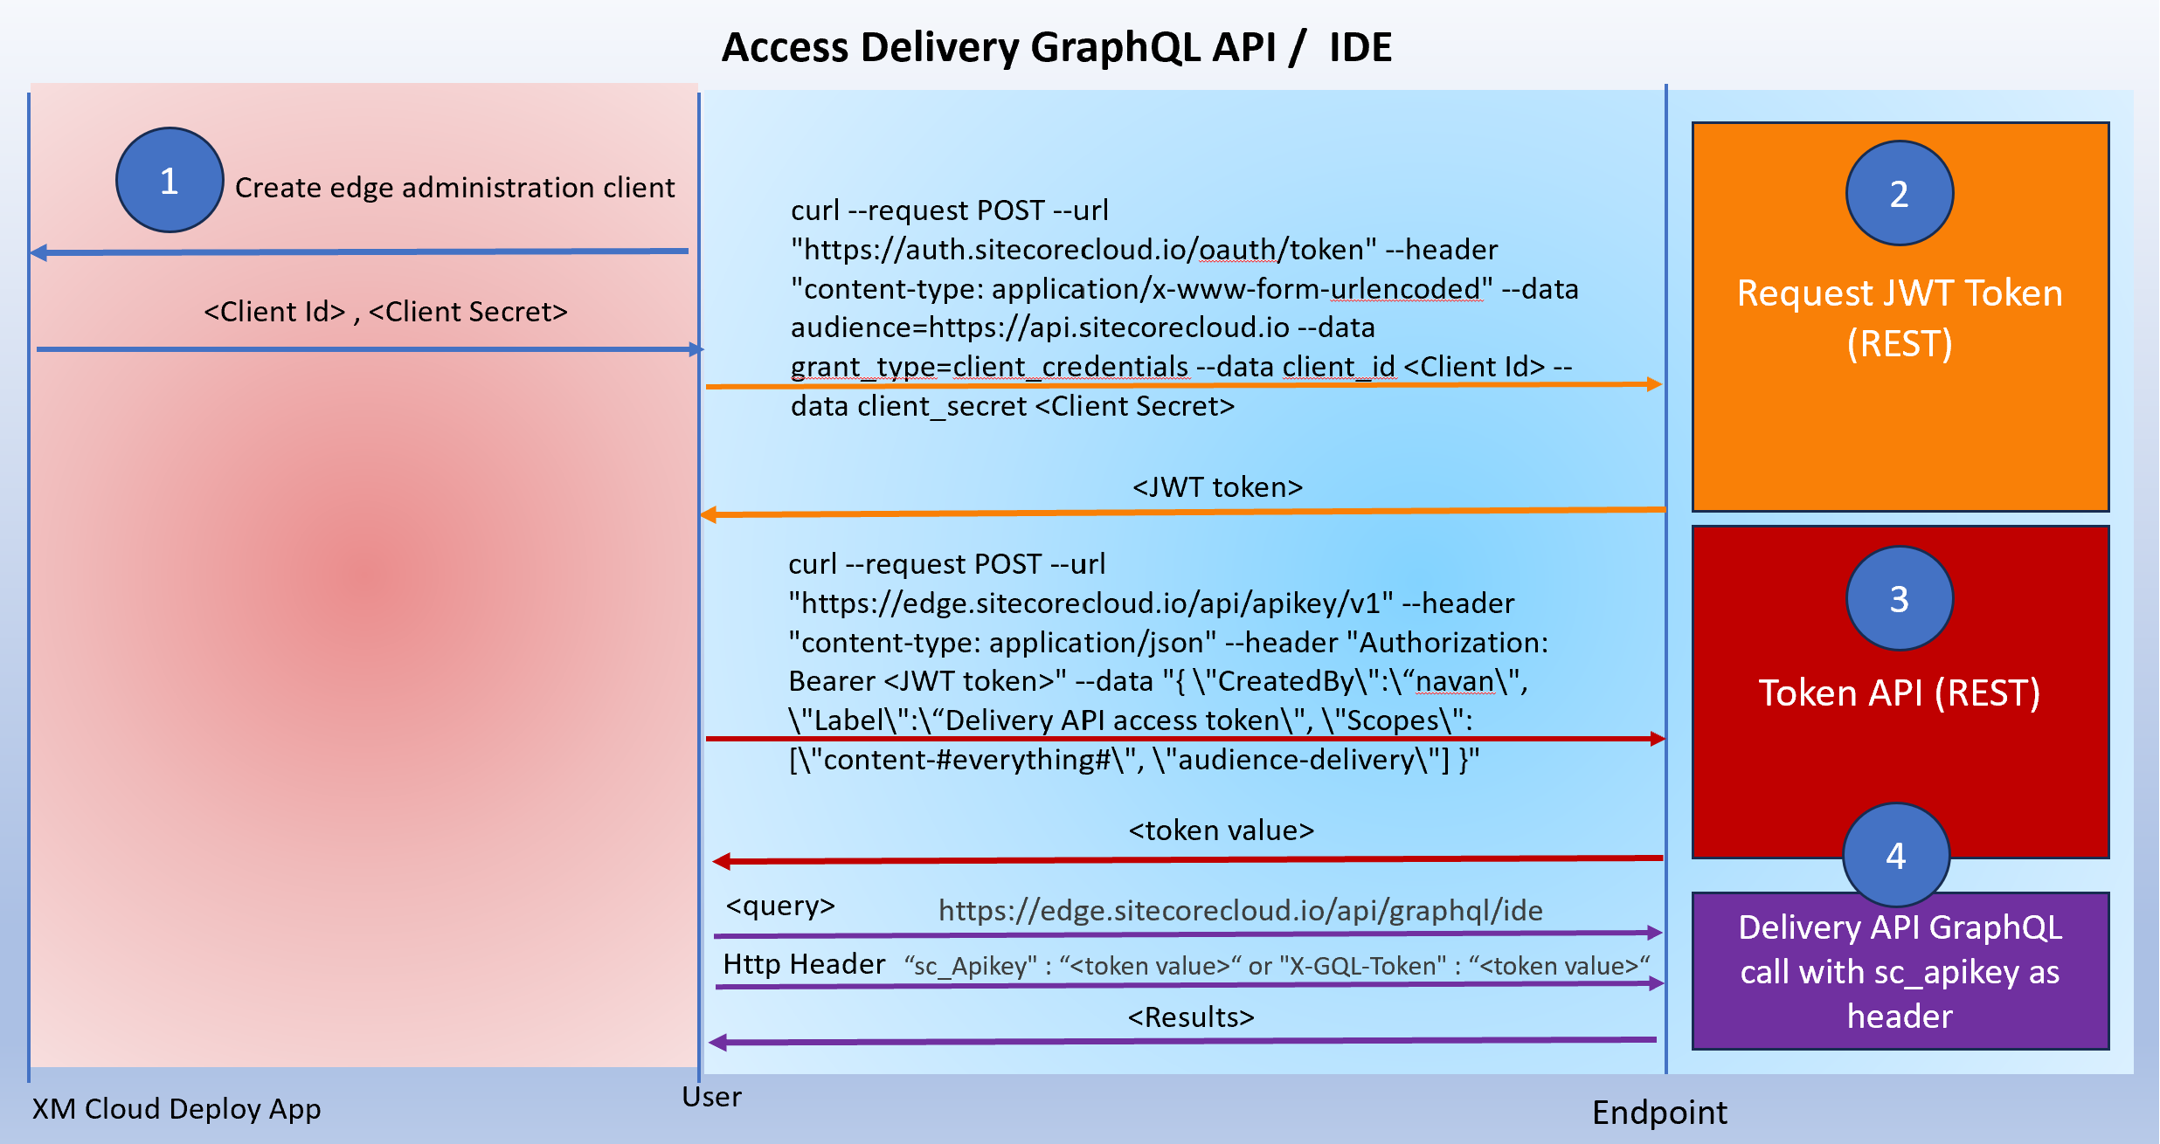
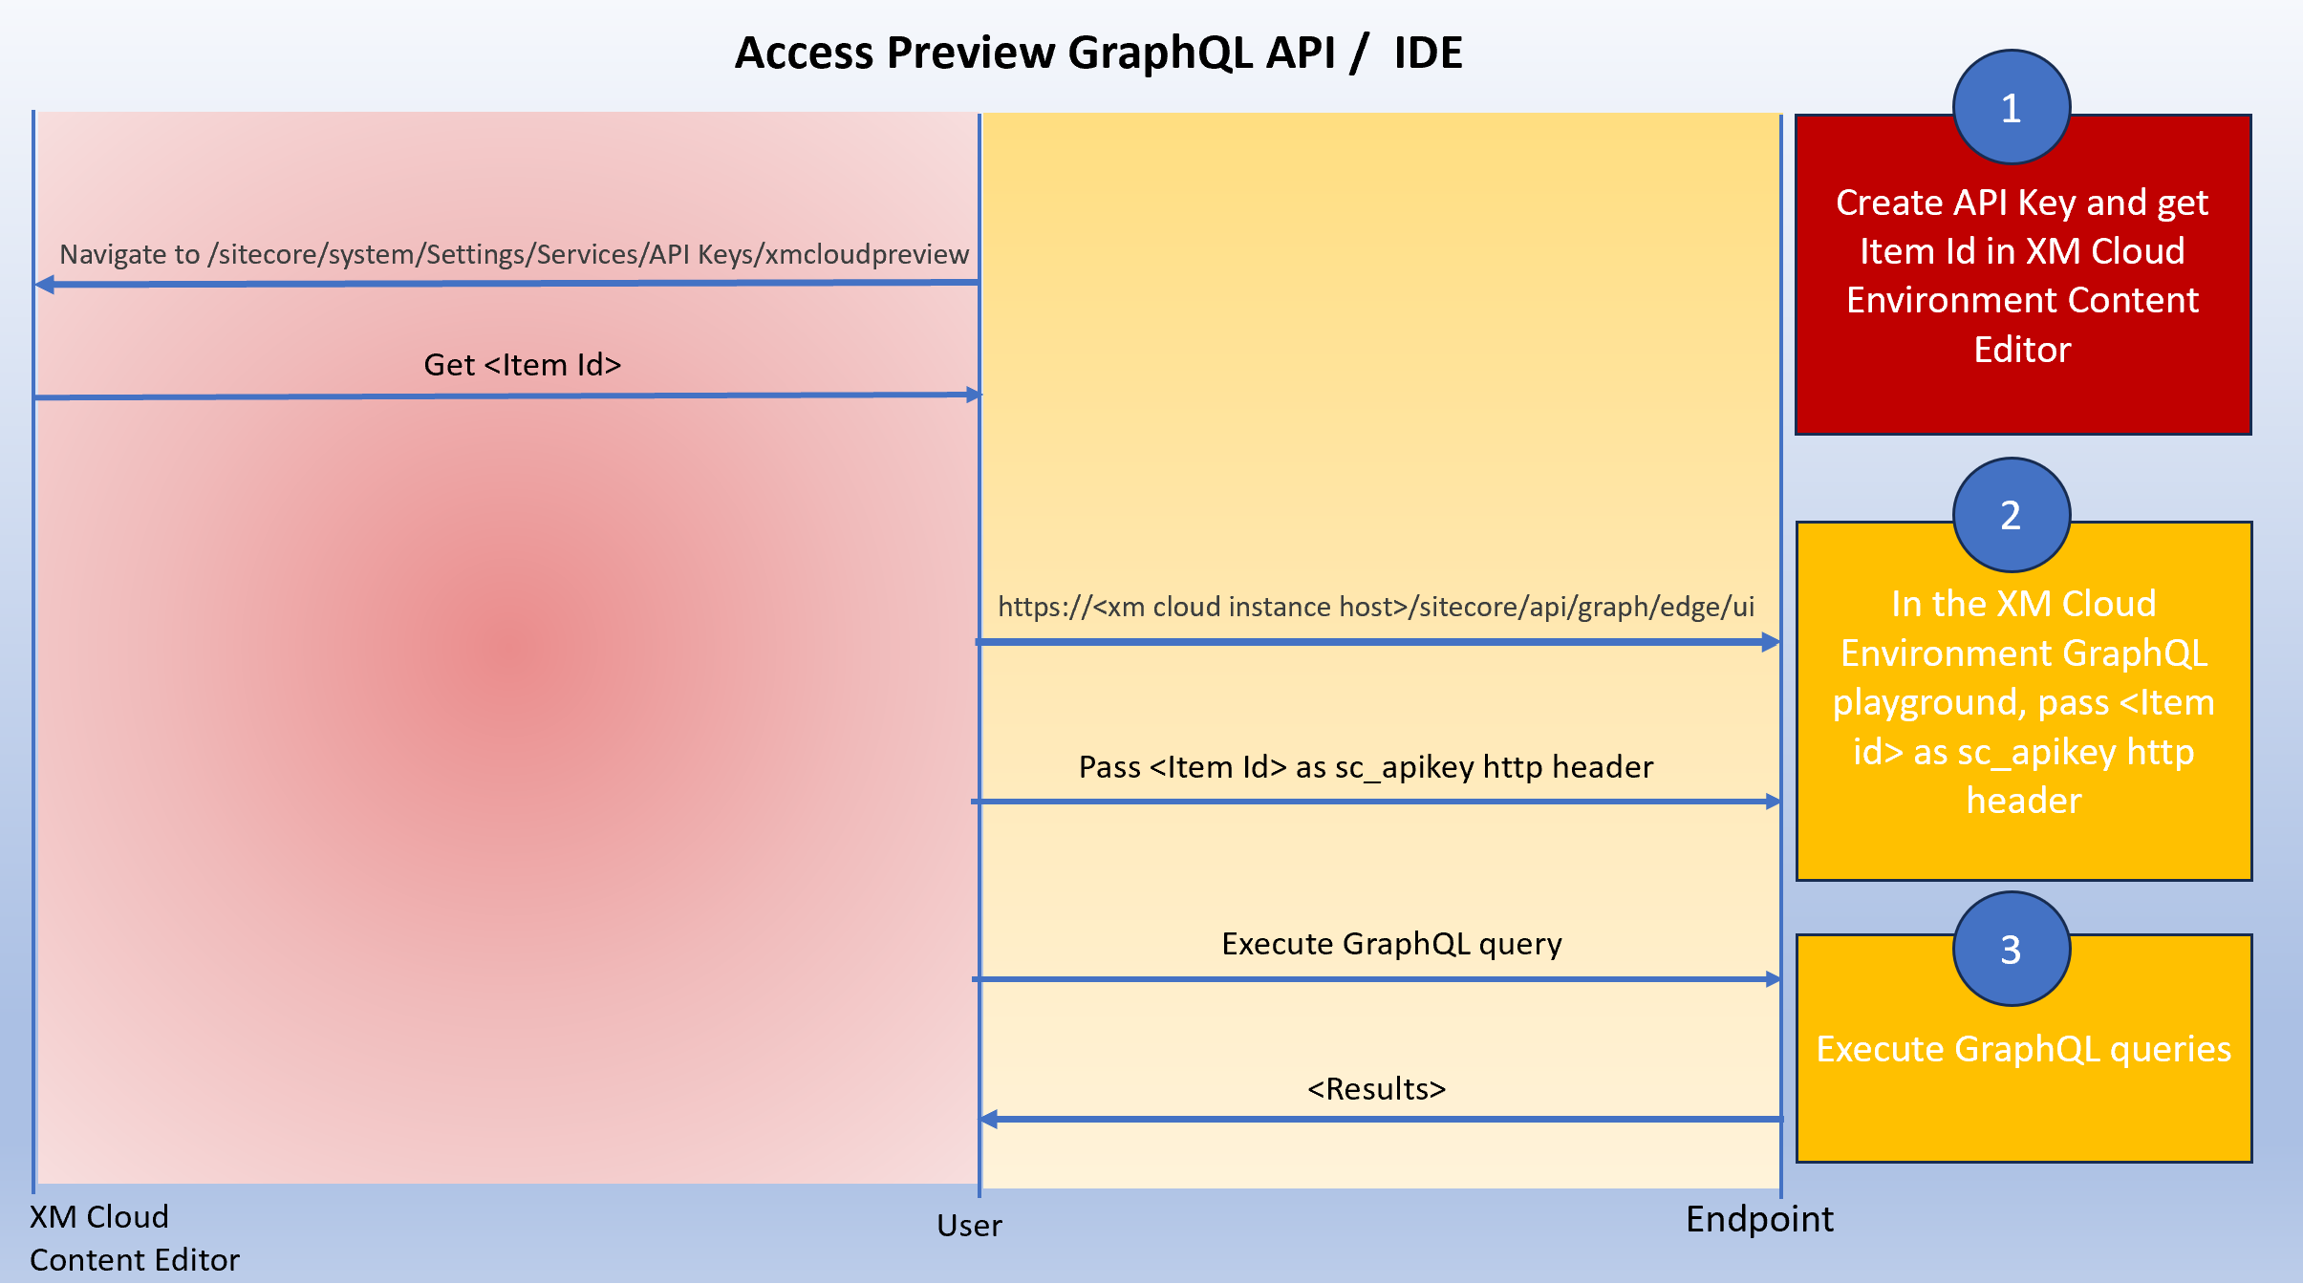
Connect Local rendering host to XM Cloud Content
Delivery API Configuration
Preview API Configuration
.env.local
.env.local
Sitecore_API_Key = <sc_apikey value>
Graph_QL_Endpoint = https://<xm cloud instance host>/api/graph/edge
JSS_APP_NAME = <site name>
Sitecore_API_Key = <token value>
Graph_QL_Endpoint = https://edge.sitecorecloud.io/api/graphql/v1
JSS_APP_NAME = <site name>
Now, in the rendering host root directory, execute npm install followed by npm run start:connected to see following end-result
Local rendering host
Delivery API endpoint
Local rendering host
Preview API endpoint
https://www.youtube.com/watch?v=wdyIkUb8uDY&t=623s
https://doc.sitecore.com/xmc/en/developers/xm-cloud/walkthrough--connecting-the-next-js-application-directly-to-the-experience-edge-endpoint.html
https://github.com/sitecorelabs/xmcloud-foundation-head/blob/main/src/sxastarter/.env

Slide 62
XM Cloud Deploy APIs
CRUD operations at following entity-levels + associated schemas as per Swagger documentation:
Base Images
Deployments
Environments
Hosting
Hosts
Organizations
Clients
Source Control
Projects
https://xmclouddeploy-api.sitecorecloud.io/swagger/index.html

Slide 63
Competency 5 - GraphQL Queries and Mutations
Management operations
Archiving
Database
Indexing
Job
Language
Publishing
Security
Workflow
Rules
Authoring operations
Item
Media
Search
Site
Template
https://doc.sitecore.com/xmc/en/developers/xm-cloud/query-examples-for-management-operations.html

Slide 64
GraphQL Reference
Mutations have “mutation” and “input” keywords while queries have “query” and an optional “result” keyword else two flower braces representing each respectively. Another syntax is to include the result fields in a nested brace within the query braces itself.
Example | Explanation
query { layout(language: "en", routePath: "/", site: "site1") { item { rendered } } site { siteInfoCollection { name routes(first: 10, language: "en") { results { routePath route { id } } } } } } | Query that returns the first 10 pages (routes) in English of "site1", with their paths and item IDs
mutation { createItem( input: { name: "Sitecore Authoring and Management API" templateId: "{76036F5E-CBCE-46D1-AF0A-4143F9B557AA}" parent: "{110D559F-DEA5-42EA-9C1C-8A5DF7E70EF9}" language: "en" fields: [ { name: "title", value: "Welcome to Sitecore" } { name: "text", value: "Welcome to Sitecore" } ] } ) { item { itemId name path fields(ownFields: true, excludeStandardFields: true) { nodes { name value } } } }} | Mutation that creates an item passing item/template details and returns the created item id, name and path
https://doc.sitecore.com/xmc/en/developers/xm-cloud/query-examples-for-authoring-operations.html

Slide 65
Competency 5 - GraphQL Reference
Example | Explanation
query { layout(site: "experienceedge", routePath: "/", language: "en") { item { homeItemPath: path contentRoot: parent { id path } } }} | Get the root item of a site: Using layout query
query { site { siteInfo(site: "example") { routes(language: "en") { results { route{ id } routePath } total pageInfo { endCursor hasNext } } } }} | Get all site paths/pages
query { # path can be an item tree path or GUID-based id item(path: "/sitecore/content/Experience-Edge/home", language: "en") { # items can be cast to a Template type with inline fragments ... on AppRoute { pageTitle { value } } # fields can be cast to a Field type with inline fragments field(name: "pageTitle") { ... on TextField { value } } }} | Get an item by ID or path and use inline fragments for casting
query { site { siteInfoCollection{ name rootPath } }} | Get information about all content sites
https://doc.sitecore.com/xmc/en/developers/xm-cloud/query-examples.html

Slide 66
Important points
From the deployment log, you can also cancel a running deployment, rerun a failed deployment, promote the deployment to another environment, download logs, or open the XM Cloud Dashboard.
If a user is a member of several roles and one of these roles is specifically denied an access right to an item, the user is denied the access right.
If source code repository is other than GitHub, use Sitecore XM Cloud CLI for deployment
createItem GraphQL mutation is used to create Sitecore items
Using the GraphQL IDE requires that you are at least in the sitecore\Sitecore Client Users role.
Admin API: ClearCacheForTenant - Clears the entire cache for a given tenant.
The Sitecore Authoring and Management API provides a single endpoint and schema that allows you to manage your Sitecore content using GraphQL.
Rendering variant is useful to display the same data structure in different ways
Sitecore Data Exchange Framework is designed to facilitate data transfer between Sitecore and third-party systems

Slide 67
Competency 6
XM Cloud Pages (aka) Sitecore Pages

Slide 68
Competency 6 (5 questions)
Create and edit items using Sitecore Pages
Add and modify components and component properties
Add components to placeholders
Differentiate between Front End as a Service components and Headless SXA Components
Add and change a component's data source
Modify a component's Grid layout settings
Use workflow to publish content
Preview a page on multiple devices
Resources: (opens in a new tab)(opens in a new tab)Pages(opens in a new tab)
FEaaS Components(opens in a new tab)
Headless SXA Components(opens in a new tab)
Data sources(opens in a new tab)
Grid(opens in a new tab)
Publishing to Experience Edge(opens in a new tab)
Add and configure a device(opens in a new tab)

Slide 69
XM Cloud URLs
App | URL
Portal | https://portal.sitecorecloud.io
Pages | https://pages.sitecorecloud.io
Deploy | https://deploy.sitecorecloud.io
Components | https://components.sitecorecloud.io

Slide 70
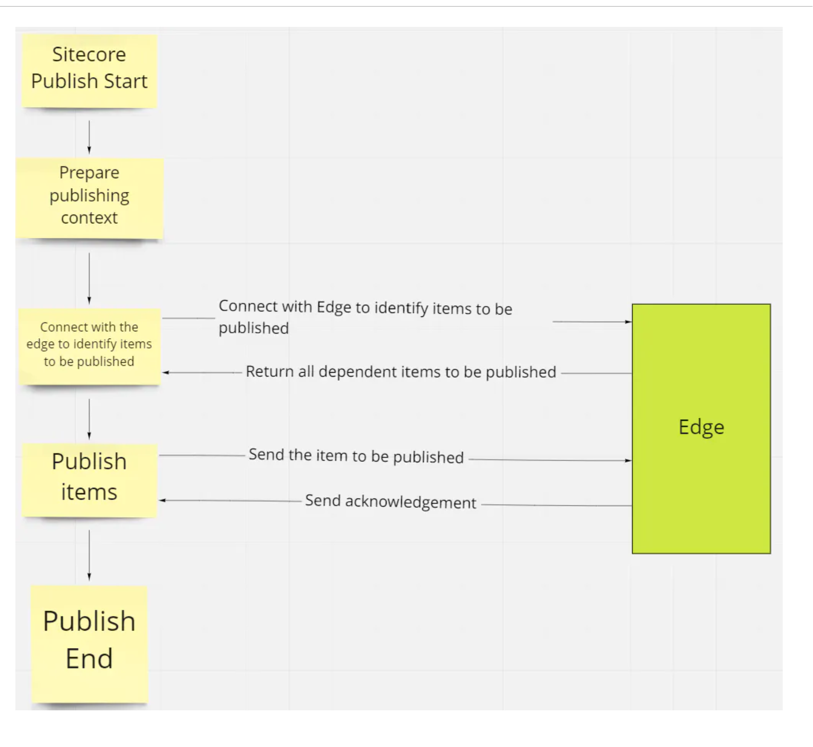
Competency 6 - Experience Edge (Connector) Publishing Process – Another view

Slide 71

Competency 6 - XM Cloud Publishing tools
Feature | Pages | Explorer | Content Editor | Exp Editor
Publish an item and sub-items
Work with versions
Schedule availability
Preview a web page
Publish a website
Validate an item
Pages and Explorer are new interfaces specific to XM Cloud
https://doc.sitecore.com/xmc/en/users/xm-cloud/publishing-in-xm-cloud.html

Slide 72
Competency 6 - Experience Edge (Connector) Publishing Process
First Publish
Subsequent Publish(es) – Update manifest
Content
1. Creating a Publishing Manifest
Media Library
Templates
JobStart
Manifest
JobEnd
2. Publishing the Manifest to Experience Edge
Publish Entities
https://doc.sitecore.com/xmc/en/developers/xm-cloud/the-publishing-process.html

Slide 73


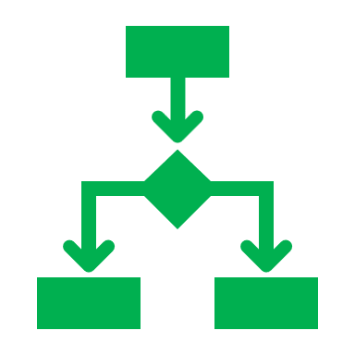

Competency 6 - Publishing Pipeline
Calculating additional entities to publish
Calculating dependencies
Resolving dependencies
Deleting old or expired content
https://doc.sitecore.com/xmc/en/developers/xm-cloud/the-publishing-process.html

Slide 74
Competency 6 - Headless sites - Configure renderings to use Dynamic Placeholders
1
Rendering Parameter template must inherit IDynamicPlaceholder
Sitecore
.tsx
Placeholder Key
3
IDynamicPlaceholder
Myrendering-{*}
In the rendering, expose the placeholder setting as part of layout service
4
Set the placeholder key
as defined in 2 like Myrendering-{*}
Rendering Parameter Template
Define placeholder key in Placeholder Setting item like
Myrendering-{*}
2
https://doc.sitecore.com/xmc/en/developers/xm-cloud/walkthrough--configure-your-renderings-to-use-dynamic-placeholders.html

Slide 75


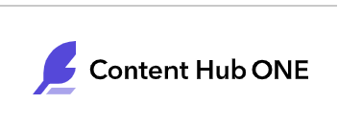
Competency 6 - XM Cloud Components (FEaaS) – Data Sources
Providers
Formats
Static JSON
Component Builder
REST
GraphQL
No-code for connecting to such external applications while headless components need code to do the same
https://www.youtube.com/watch?v=roCDkTUDWfk

Slide 76



Competency 6 - Component and Versions
Name
Name
Gender
Gender
About
About
Version - 3
Break Point
Version - 1
Break Point
Name
Name
Gender
Gender
About
About
Break Point
Component
Version - 2
One component with multiple versions based on screen breakpoints

Slide 77
Component Staging and Publish States
Draft
Never Staged
Staged
Previously Staged
Unstaged
Never Published
Published
Previously Published
Unpublished
Changed
Up to date
Archived
https://doc.sitecore.com/xmc/en/users/xm-cloud/staging-and-publishing-components.html

Slide 78
Competency 6 - XM Cloud Component in Pages
Site Setting
Pages
Component Builder
F
E
A
A
S
XM Cloud CM Instance
Content
Field-1
Map
Data sources
Data templates
Select Data Source
Content
Staged
Field-2
Map
Content
Field-3
Map
Pages
Component
Content Item
https://www.youtube.com/watch?v=zfD6oaifp_g

Slide 79
Competency 6 - Configure devices for Pages
Specify the following fields:
a. Device width - set the width of the simulated device in Pages. The unit of measure is pixels.
b. Visibility:
Disabled - make this type of device unavailable for selection.
Fixed - make this type of device available for selection at the top of the content area.
Optional - make this type of device available for selection from a list at the top of the content area.
c. Icon - browse to select an image for the device from the Media Library, or enter a path to an image.
https://doc.sitecore.com/xmc/en/developers/xm-cloud/add-and-configure-devices-in-pages.html

Slide 80
Competency 7
Security for Developers

Slide 81
Competency 7 (5 questions)
Create users in the Sitecore Cloud Portal
Configure and assign roles in the Sitecore XM Cloud Role Manager
Manage permissions for items, roles, and users
Configure multifactor authentication
Resources: (opens in a new tab)Sitecore Cloud Portal administration(opens in a new tab)
User security(opens in a new tab) (opens in a new tab)
Users, roles, and domains(opens in a new tab)
Create and set up a role(opens in a new tab)
The security roles(opens in a new tab)
The access rights(opens in a new tab)

Slide 82


Competency 7 - User and Security Role
Access Right Setting
Access Right
Item-1
Allow
Read
Assign
Assign
Item-2
Assign
Role
User
Deny
Write
Assign
Item-3
Security best practice: Assign user to roles, and assign rights to roles
Inherit
Delete
https://doc.sitecore.com/xmc/en/developers/xm-cloud/assigning-access-rights.html
https://doc.sitecore.com/xmc/en/developers/xm-cloud/the-access-rights.html

Slide 83
Competency 7 – Sitecore XM Cloud Security Tools
User Manager | Role Manager | Domain Manager | Access Viewer | Security Editor | Content Editor – Security Tab
Create, edit, and delete users | Create and delete roles. | Create and delete domains. | Sitecore item access rights overview for each role/user. | Assign access rights to roles and users | Assign access rights to roles and users
Change the password of users | Add or remove users and roles as members of a role. | Specify whether the domains are global or locally managed. | See an explanation of how the current settings have been resolved. | Protect and unprotect items | Change the ownership of an item.
Enable and disable users | Open the other security tools. | Open other security tool | Open the Security Editor and the User Manager. | Open the Access Viewer and the User Manager | Get an overview of the roles and users that have access rights to individual content tree items.
Lock and unlock users |  |  |  |  | Open the Access Viewer and the User Manager.
Open the other security tools
https://doc.sitecore.com/xmc/en/developers/xm-cloud/assign-access-rights-to-a-security-account.html

Slide 84
Competency 8
Data Modeling

Slide 85
Competency 8 (7 questions)
Create data templates, standard values, and set insert options to match the data structures outlined in a development plan.
Configure base templates for a data template
Create fields on a data template
Manage language and numbered versions of items
Data Model mapping to Experience Edge Schema
Resources: (opens in a new tab)Data templates(opens in a new tab)
Standard values(opens in a new tab)
Insert options(opens in a new tab)(opens in a new tab)
Add a language version to an SXA site(opens in a new tab)
The Experience Edge schema(opens in a new tab)(opens in a new tab)
Admin API

Slide 86
Competency 8 - Template Inheritance (Duplicate field behavior)
Animal
Name
Gender
Age
Dog
Name
Gender
Age
Dog
Name
Name
Height
Height
Weight
Weight

Slide 87
Competency 8 - Add a language version to SXA Site
End-Result
Version
Site
Item-1
Version
Add Site Language Script
Version
Item-1
Item-1
Site
Item-2
Item-2
Item-2
Version
Item-3
Item-3
Existing Language
New Language
Version
Item-3
Note that this script is intended to just add a new language version for Sitecore items but doesn’t translate content
Version
https://doc.sitecore.com/xmc/en/developers/xm-cloud/add-a-language-version-to-an-sxa-site.html

Slide 88
Competency 8 - Experience Edge Admin API Endpoints
Base URL: https://edge.sitecorecloud.io/api/admin/v1
Endpoint | Description | Relative Path | Verb
ClearCacheForTenant | Clears the entire cache for a given tenant | /cache | Delete
DeleteContent | Removes tenant data from the data storage. | /content | Delete
GetSettings | Lists all available settings for a tenant. | /settings | Get
UpdateSettings | Updates all available settings for a tenant | /settings | Put
PatchSettings | Updates a setting for a tenant using one or more Patch operations. | /settings | Patch
CreateWebhook | Creates a new webhook | /webhooks | Post
UpdateWebhook | Updates an existing webhook | /webhooks/{id} | Put
DeleteWebhook | Deletes an existing webhook | /webhooks/{id} | Delete
ListWebhooks | Deletes all webhooks in a tenant | /webhooks | Get
GetWebhookById | Gets a specific tenant webhook | /webhooks/{id} | Get
https://doc.sitecore.com/xmc/en/developers/xm-cloud/admin-api.html

Slide 89
Important points
Insert Options (set in template standard values) is mainly used to streamline options under a parent in the content tree
Standard Values help define default field values, usually go hand-in-hand with tokens
In the Content Editor, you can set placeholder restrictions for your layout placeholders. These restrictions are applied on all pages in the site
Specifying Source for a field in template helps showing a filtered data list from the concerned content tree location
Specifying Datasource location restricts the content author by allowing to look for the data source in a specific location
Remember that Access Viewer is to view security mapping while Security Editor is to edit security for user/roles
A field can get duplicated due to its presence in base template so, with template inheritance in place, ensure field names are unique
SPE scripts available for Remove Site Collection, Remove Site, Remove Site Collection Folder, or Remove Site Folder
The deployment log displays the progress, status, warnings, and errors of an XM Cloud deployment
Download XM Cloud log files with this command: dotnet sitecore cloud environment log download --environment-id <env-id> --filename <filename>

Slide 90
Additional Tips
Thorough all question/answers in eLearning study guide
Overview of GraphQL query examples
Overview of GraphQL mutations
Overview of API endpoints

Slide 91
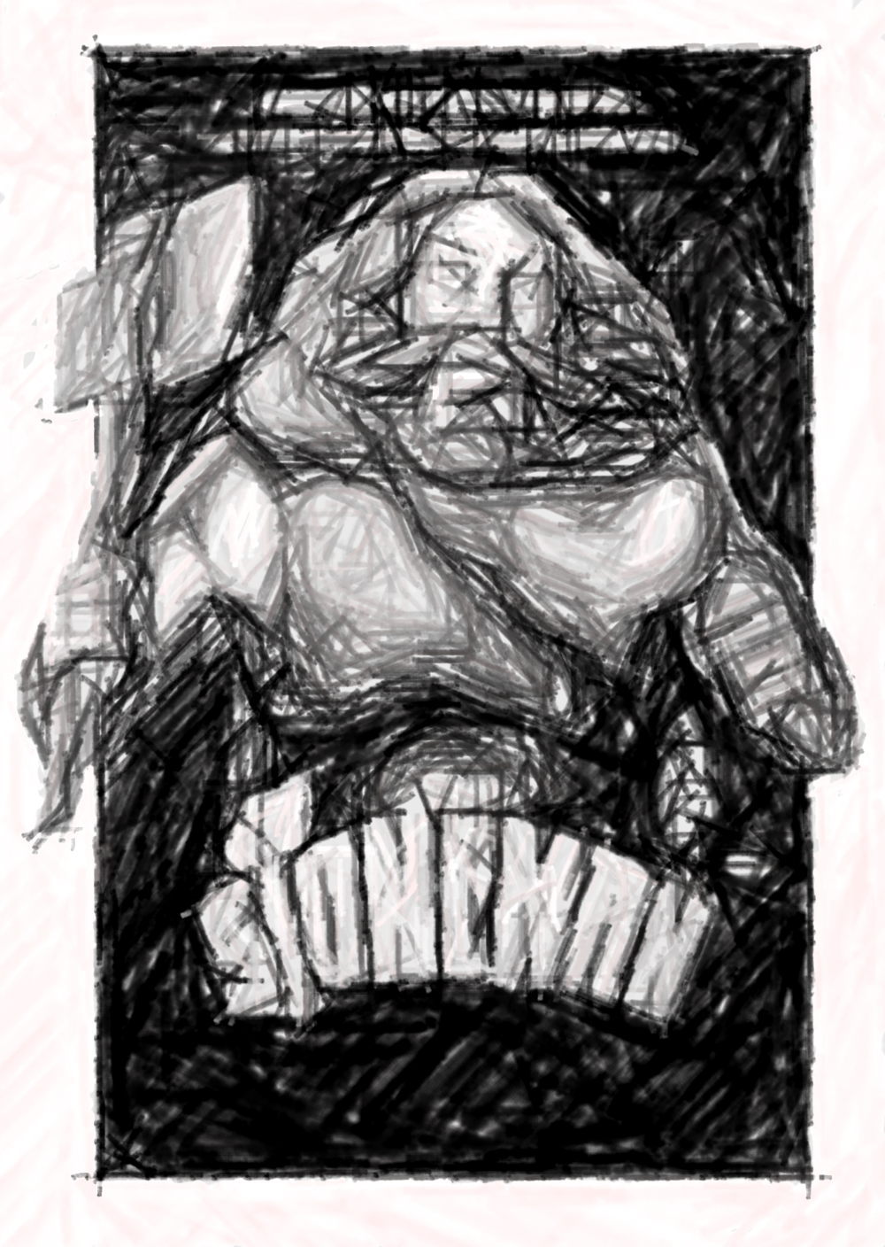

100% Loaded The Beginning

